Slide 1
Distributed Architecture
Iskander Sierra
JGIngenieros S.A.

Slide 2
CAP Theorem
The CAP theorem states that it is impossible for a distributed computer system to simultaneously provide all three of the following guarantees:
Consistency: all nodes see the same data at the same time
Availability: every request receives a response about whether it succeeded or failed
Partition tolerance: the system continues to operate despite arbitrary partitioning due to network failures

Slide 3
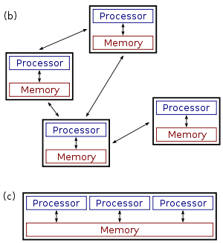
Distributed Computing
Several autonomous nodes with their own local memory and processors
The nodes communicate with each other by message passing
The system has to tolerate failures in individual nodes
The topology of the system is not known in advance and can change anytime
Each node has only a limited and incomplete view of the system
Distributed system
Parallel system

Slide 4
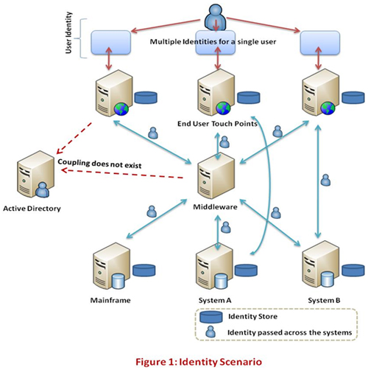
Distributed Computing
Architectures
Client-Server
Multi-tier
Peer-to-peer
Communication mode
Synchronous
Asynchronous

Slide 5
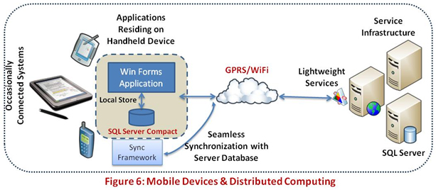
Distributed Computing
Challenges
Identity and Access Management
Load Balancing and Concurrency
Security
Governance and Monitoring
Message Exchange Models
Mobile Devices
https://msdn.microsoft.com/en-us/library/cc949110.aspx

Slide 6
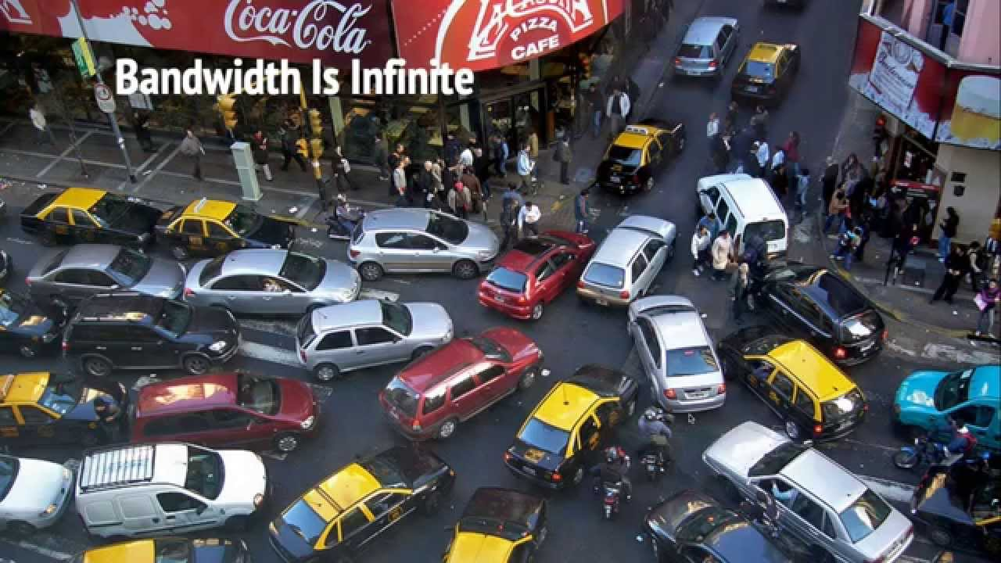
Distributed Computing
Fallacies
The network is reliable
Latency is zero
Bandwidth is infinite
The network is secure
Topology doesn’t change
There is one administrator
Transport cost is zero
The network is homogeneous
https://pages.cs.wisc.edu/~zuyu/files/fallacies.pdf

Slide 7
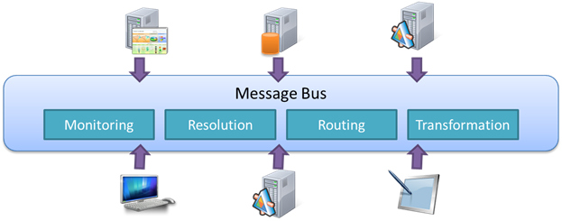
Message Oriented Architecture
Messages: Unit of data exchange
Queues: Asynchronous transport mean for a consumer
Routing: Location transparency of consumers and producers
Services: Produce and consume messages
Integration: Allows transforming messages for decoupling

Slide 8
Message Oriented Architecture
Examples of messages
A message is any relatively short data unit which conveys some information for the system producing/consuming it
1
“Hello”
<LogError>Error on remote system</LogError>
{ command: “create-order”, zone: “East Building”, date: …}

Slide 9
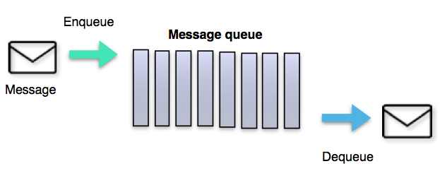
Message Oriented Architecture
Message queues
A queue is a line of things waiting to be handled - in sequential order starting at the beginning of the line. A message queue is a queue of messages sent between applications. It includes a sequence of work objects that are waiting to be processed.

Slide 10
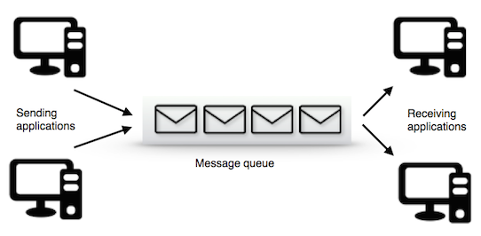
Message Oriented Architecture
Message queues features
Decoupling
Persistence
Scalability
Security
Delivery policies
Batching
Priority
Purging
Routing

Slide 11


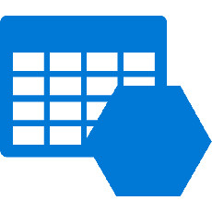



Data Persistence
Data-Model
Relational database
Document database
Key-Value store
Blob store
Table store
Column store
Index store
Graph store
Event store
Datawarehouse

Slide 12
Data Persistence
On-line Transaction Processing
Operational data
Control and run fundamental business tasks
Source of business facts
Short and fast updates
Simple queries and short results
Requires small space
Backup critical
On-line Analytical Processing
Consolidation data
Planning, problem solving and decision support
Multidimensional views
Complex stream/batch updates
Complex indexed queries
Large space, data duplication
Derived from OLTP system

Slide 13
Domain Driven Design

Slide 14
CQRS

Slide 15
Functional Programming

Slide 16
Actors Model

Slide 17
Data Visualization

Slide 18
HTTP and REST

Slide 19
Azure IaaS and PaaS

Slide 20
GIT and Source Control
Operations
GitFlow

Slide 21




Distributed Application Architecture
Targeted Apps
Mobile
Distributed
Application
Services
Communication Interface
Power Apps
Desktop / Web

Slide 22
Server-Side Message-Oriented Architecture
…
API APP
Commands
Command
Processing
Cluster
Command queue
Commands
Business
Decision
Making
Client
Notific.
…
Events
Event Hub
Messages
View
Projection
Cluster
API APP
Queries
Data
Updates

Slide 23
Communication Interface
 | Standard | Performant | Scalable | Supported | Total
HTTP/S | 5 | 3 | 5 | 5 | 18
TCP | 0 | 5 | 5 | 3 | 13
Event Hub | 2 | 5 | 5 | 5 | 17
Azure Queue | 2 | 3 | 5 | 5 | 15
Service Bus | 2 | 3 | 5 | 5 | 15
WCF/SOAP | 5 | 1 | 5 | 5 | 16

